Slide 1

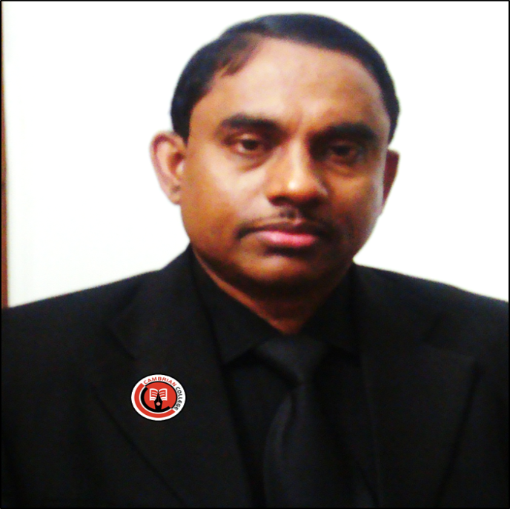
Welcome to the world of HHR PPT Presentation.

Slide 2
Identity
Md. Hasan Hafizur Rahman
Senior Teacher (English)
Cambrian School and College
Building -5
Baridhara,Dhaka
Email: hasancambrian@gmail.com
English 2nd Paper
Class IX-X

Slide 3
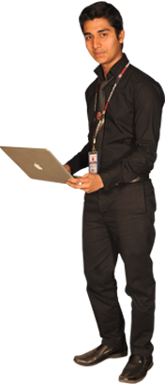


What is followed by the pictures?
Sitting before/front
Sitting after/back

Slide 4
Our Today’s lesson is--
Suffix and prefix

Slide 5
Learning outcomes
After completing this lesson, we will be able to-
identify the definition of suffix and prefix
differ suffix and prefix
use suffix and prefix in the sentence

Slide 6
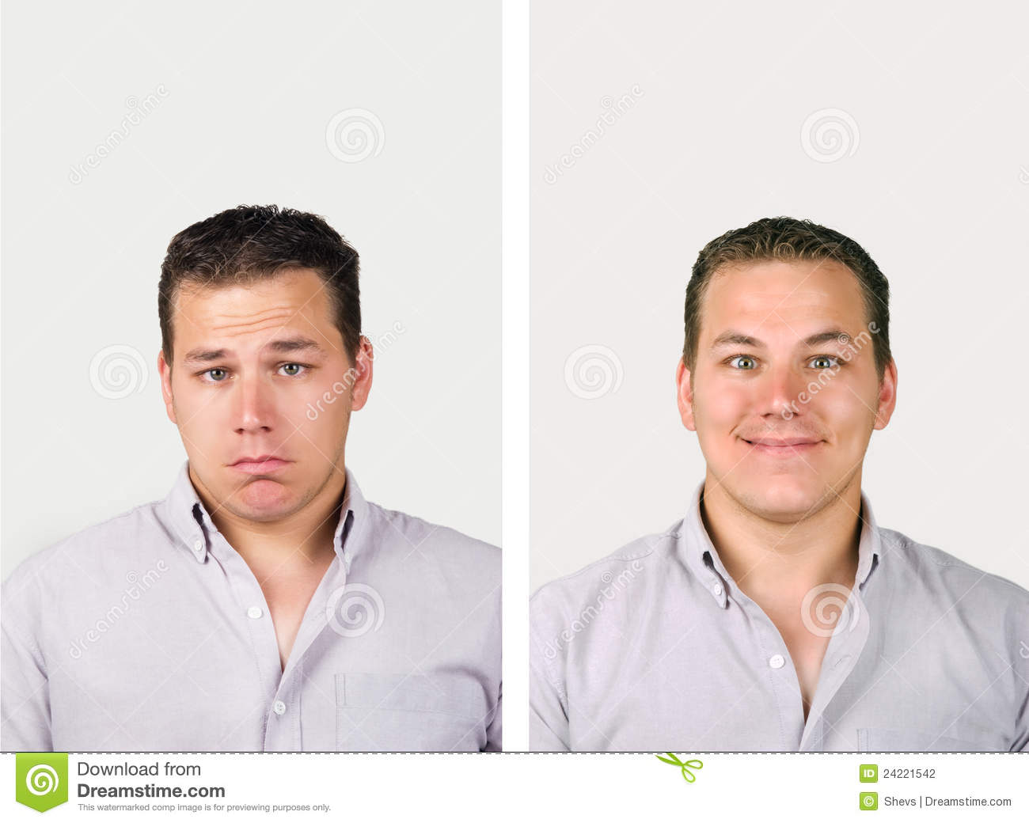
The man looks
happy.
unhappy.
What is it?
un
happy
অ
সুখী
What is it?
happ
ily
y

Slide 7
Follow carefully
Prefix
Suffix
abl
un
able
e
ity
Added before
Added after
Letter or letters added
before any word and
changes its meaning
is called prefix.
Letter or letters added
after any word and
change its form
is called suffix.

Slide 8
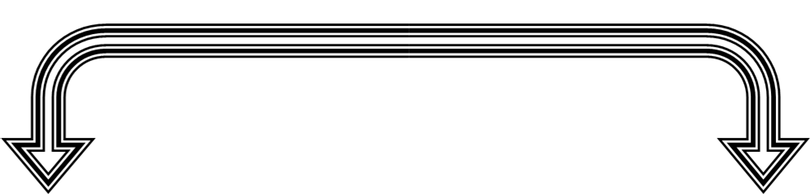
What is the difference between suffix and prefix?
Differences
Prefix is added before a word and changes its meaning
suffix is added after a word and changes its form.
Examples of some prefix: un, in, im, en etc.
Examples of some suffix: tion, ity, ly,ness, ment etc.
Note: Prefix is added directly before the word
Note: If the last letter of the word is e, t, it is omitted while adding suffix.

Slide 9
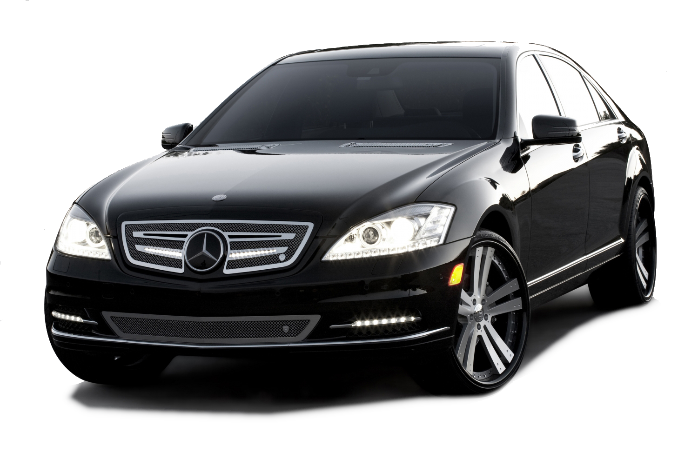
Add suffix or prefix with the word in bracket.
He has no _________ (able) to buy a car.
ability

Slide 10
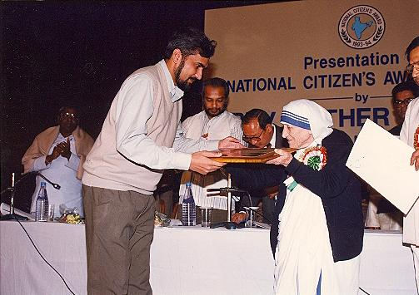
Add suffix or prefix with the word in bracket.
Mother Teresa was rewarded for her ________ (human).
humanity

Slide 11
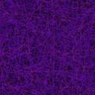
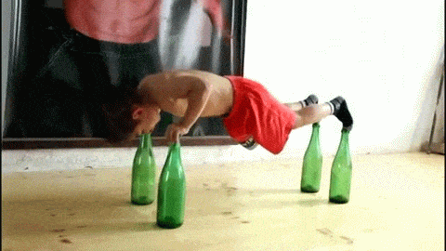
Add suffix or prefix with the word in bracket.
The___________ (perfect) of his performance is really ___________ (wonder).
perfection
wonderful

Slide 12


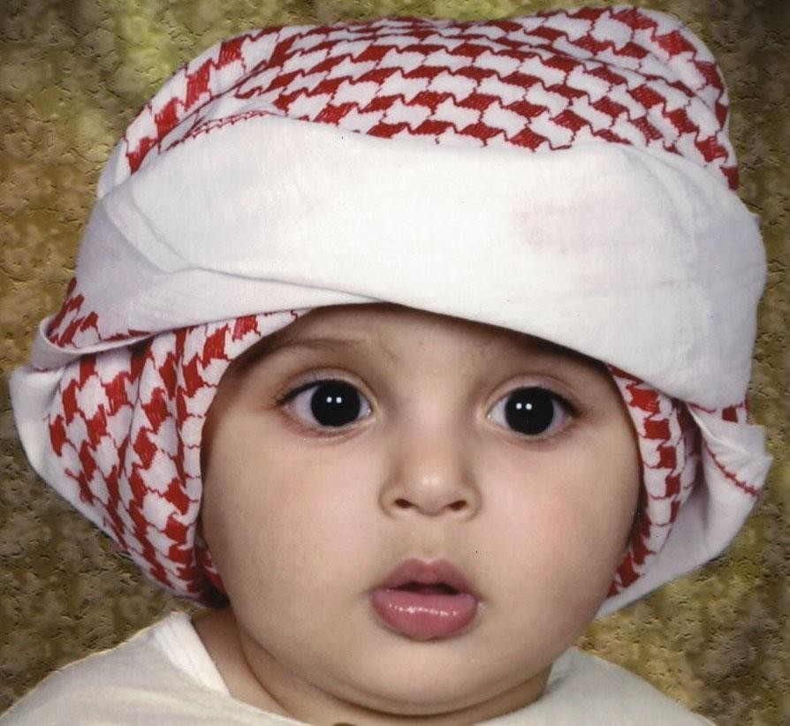
Add suffix or prefix with the word in bracket.
Our parents always __________(courage) us to put on these dress.
encourage

Slide 13

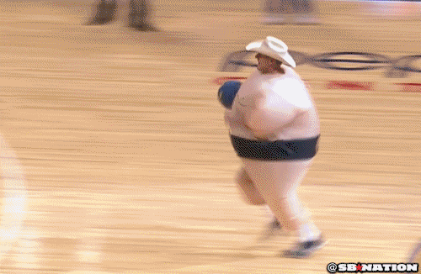
Add suffix or prefix with the word in bracket.
What a beautiful __________(perform) he displayed!
performance

Slide 14
Individual work
Complete the text adding suffixes, prefixes or the both with the root words given in the parenthesis.
In the past people did not have developed (a) _______ (communicate) facilities. They used to make (b) _______ (move) to short distant places on foot. Nowadays, they go by rickshaw," taxi or by other kinds of (c)_______ (motor) vehicles. As a result, they do not undergo physical (d) _______ (exert) -— which is good for health. The ultimate result is that many a man is now getting diabetics. The (e) _______(suggest) is that we should form the habit of walking. Walking (f) _______ (able) us to (g) _______ (joy) the beauty of nature. It also helps us have physical (h) _______ (fit). But some people are (i) _______ (different) to walking. They give (j) _______ (prefer) to vehicles.
Check your answer
(a) communication; (b) movement; (c) motorized; (d) exertion; (e) suggestion; (f) enables; (g) enjoy; (h) fitness; (i) indifferent; (j) preference.

Slide 15
Home work
Differentiate the suffix and prefix of the word of the following passage after adding suffix and prefix.
Smoking produces (a) ___ (danger) effects on man. By smoking a man, incurs both physical and (b) ___ (economy) loss. The butt end of a cigarette often causes a (c) ___ (devastate) fire. Smoking is a kind of (d) ___ (addict). Those who become (e) ___ (addict) to drug first begin smoking which is the initial step to addiction. We should (f)____(smoking) (g) ___ (aware) among our people. It is (h) ___ (possible) ___ to stop smoking by giving (i) ___ (punish). (j) ___ (out) effort from everybody is essential to minimize smoking.

Slide 16
This is all for today.
Allah Hafez.

